Slide 1
“Opportunities for PCS”
Presented by:
CS Nesar Ahmad
Past President, The ICSI
csnesar367@gmail.com
Mob: 9810044367

Slide 2
Historical Background
Major Milestones
1988 - For the 1st time practicing side of the profession was recognised by the government:
Amendment in the Companies Act, 1956 mandating certification of annual return of listed entities.
Subsequently, recognition given by many more small amendments both under the Companies Act as well under Securities Laws.
1999 - FEMA replaced FERA and recognized the profession of CS in FC-GPR and FC-TRS.

Slide 3
Historical Background
Major Milestones
Government also recognized various certifications by PCS under EXIM Policy.
2000 - Major recognition given by CG to PCS:
Amendment in Section 383A whereby ‘Compliance Certificate’ was made mandatory for certain class of companies.
With this requirement PCS started getting major recognition.

Slide 4
Historical Background
Major Milestones
2013 - Existing Companies Act was adopted and various recognitions were granted statutorily like Section 92, 204, 432 etc.
2015 – SEBI (LODR) – Recognized PCS.
2016 – Introduction of IBC – recognition to act as IRP/ RP / Valuer.
2019 – Compliance Certificate for a listed Company.

Slide 5
Areas of practice
Corporate Governance & Secretarial Services
Corporate Governance Services
Corporate Secretarial Services
Secretarial/ Compliance Audit and certification Services
Corporate Laws Advisory & Representation Services
Corporate Laws Advisory Services
Representation Services
Arbitration & Conciliation Services

Slide 6
Areas of practice
Financial & Advisory Services
Public Issue, listing and Securities Management
Takeover Code, Insider trading, Mergers & Amalgamation
Securities Compliance and Certification Services
International Trade & WTO Services
Taxation Services
Finance & Accounting Services

Slide 7
Areas of practice
Management Services
General/ Strategic Management Consulting
Corporate Communication and Public Relations
Human Resources Management

Slide 8
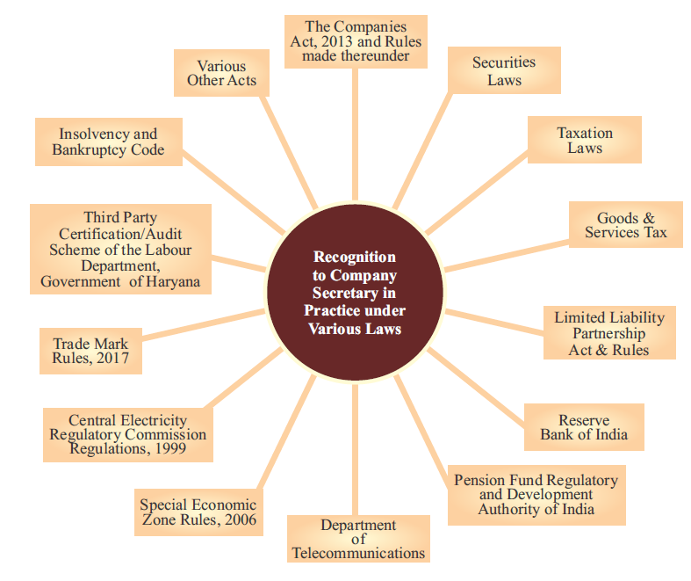

Slide 9
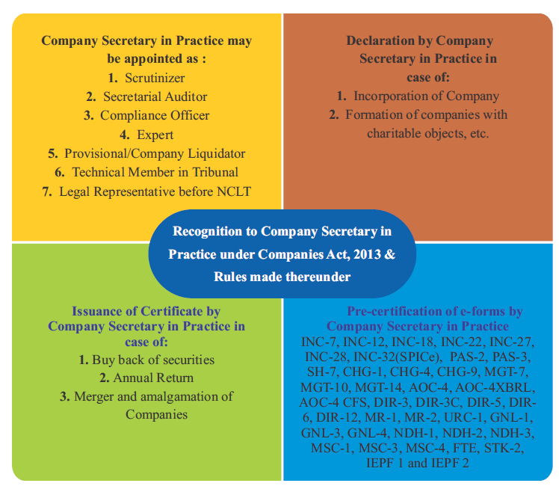

Slide 10
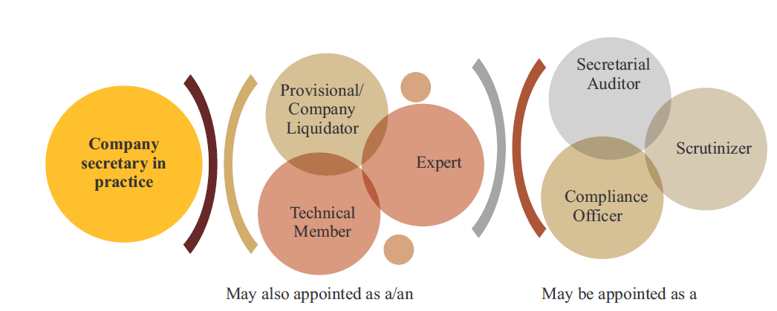

Slide 11
Declaration
Incorporation of Co.
Section 7
Formation of Co. with Charitable Objects etc. Section 8
Form INC-14
Many Others

Slide 12
Compliance Certificate
In respect of Buy Back of Securities in Form No. SH-15
Certification of Annual Return
Form MGT-8
Merger & Amalgamation
Certificate whether the scheme is being complied with in accordance with the orders of NCLT or not

Slide 13
Companies Incorporation Rules, 2014
Simplified Proforma for Incorporating Company Electronically (SPICe +) INC-32
Application for grant of license u/s 8
INC-12
Application for conversion of Section 8 Co. into other kind of Co.
INC-18
Notice of situation or change of Registered Office INC-22
Conversion of Public Co. into Pvt. Co. or vice versa
INC-27

Slide 15
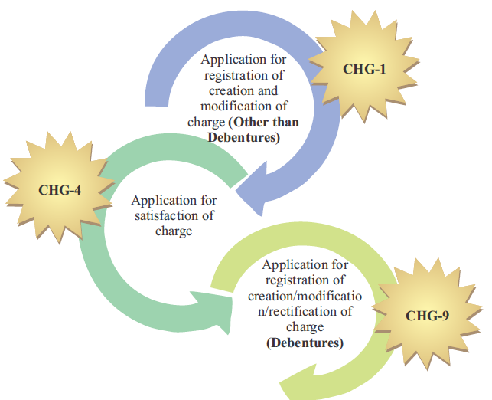

Slide 16
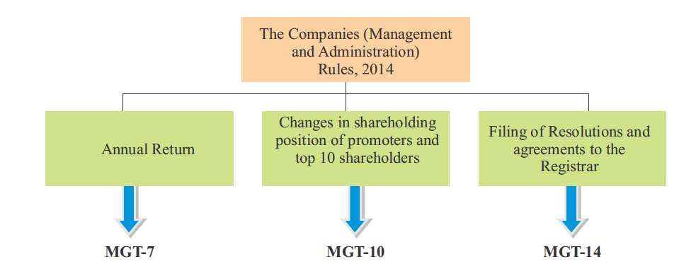
*
* Deleted in 2018

Slide 17
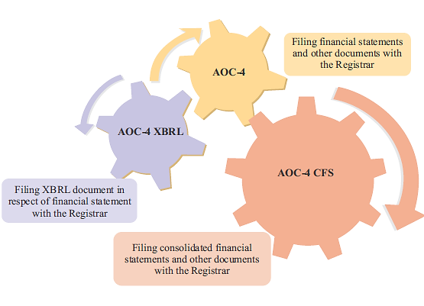

Slide 18
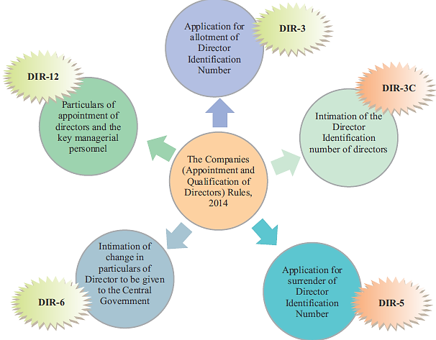

Slide 19
MR-1
Return of appointment of MD or WTD or manager
MR-2
Application to the CG for approval of appointment / reappointment and remuneration or increase in remuneration or waiver for excess or over payment to MD or WTD or manager and commission or remuneration to directors

Slide 20
GNL-1 : Form for filing application with Registrar of Companies (ROCs)
GNL-4 : Form for filing Addendum for rectification of defects or incompleteness
GNL-3 : Form for Particulars of person (s) or Key managerial personnel charged or specified for the purpose of Section 2 (60)

Slide 21
Form NDH-1
Return of Statutory Compliances
Form NDH-2
Application for extension of time
Form NDH-3
Half Yearly Return
Application for declaration as Nidhi Company & for updation of status by Nidhis
Form NDH-4

Slide 22
IEPF-1
Statement of amounts credited to Investor Education & Protection Fund
IEPF-2
Statement of unclaimed and unpaid amounts

Slide 23
INC-28
Notice of Order of the Court or Tribunal or any other competent authority
SH-7
URC-1
STK-2
Notice to Registrar of any alteration of share capital
Application by a company for registration under section 366 (conversion from firm into company and LLP into company)
Application by company to ROC for removing its name from Register of Companies

Slide 24
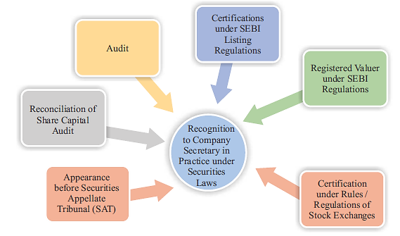

Slide 25
CS CERTIFICATION-INTERNATIONAL TRADE
.
Certificate of CS for issue of EPCG authorization
.
Certificate of CS for redemption of EPCG authorization / issuance of post export EPCG duty credit scrip
Facility to upload documents (like Annexure to Document ANF 3B, 3C & 3D) by CS under export from India schemes under Foreign Trade Policy
.

Slide 26
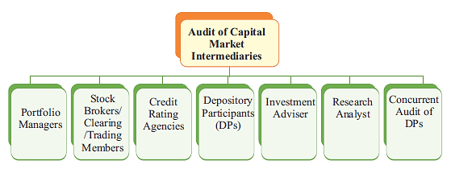

Slide 27
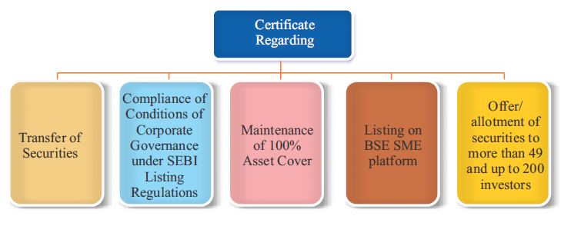

Slide 28
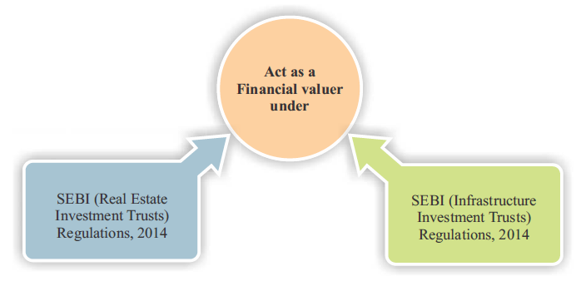

Slide 29
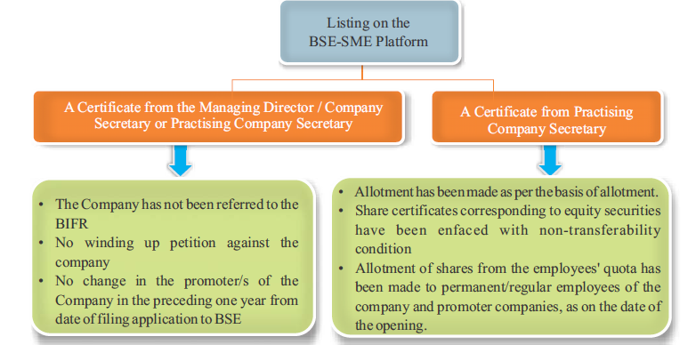

Slide 30
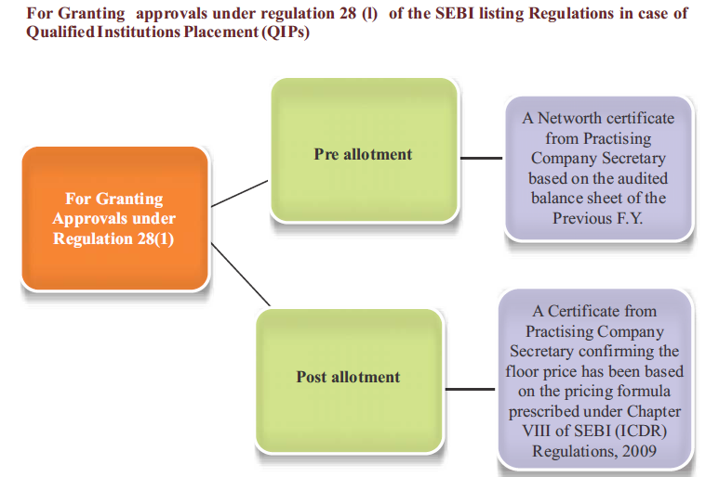

Slide 31
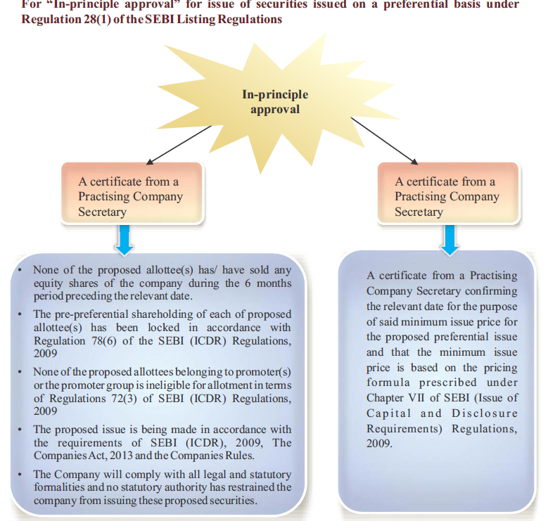

Slide 32
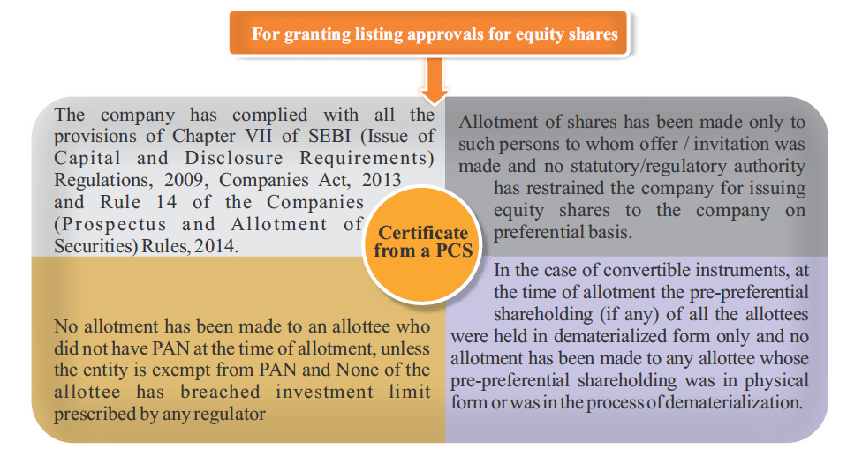

Slide 33
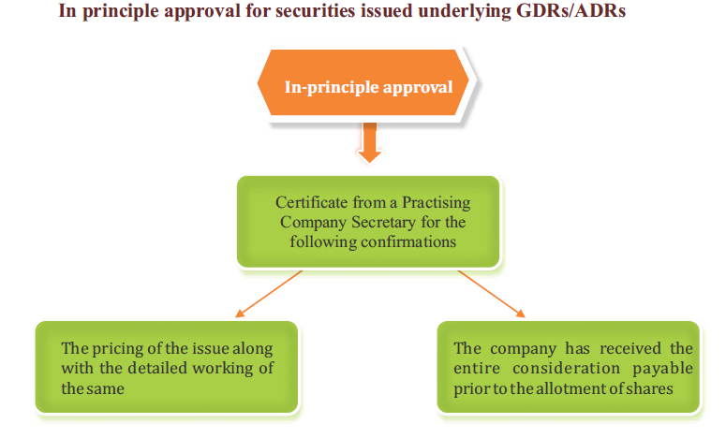

Slide 34
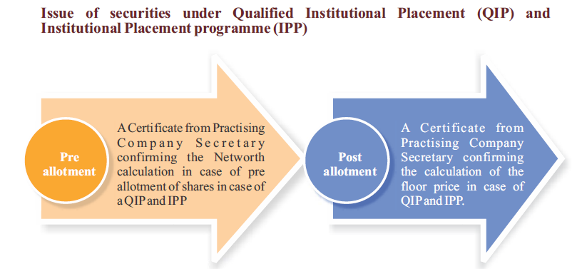

Slide 35
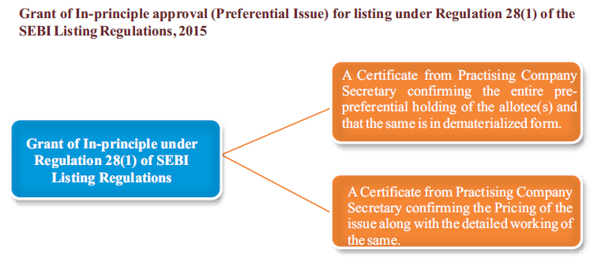

Slide 36
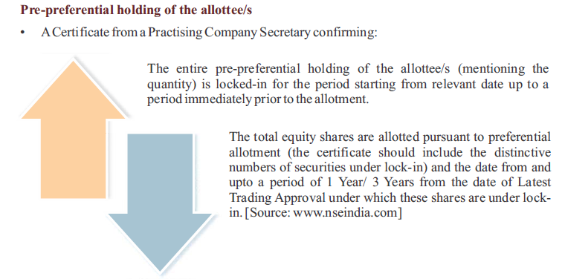

Slide 37
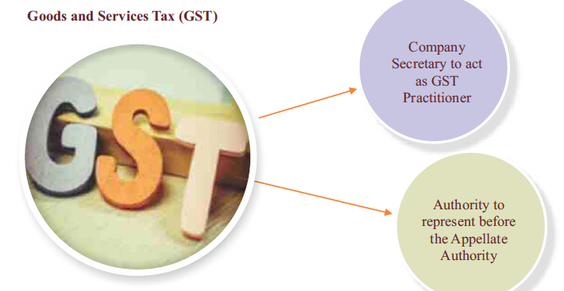

Slide 38
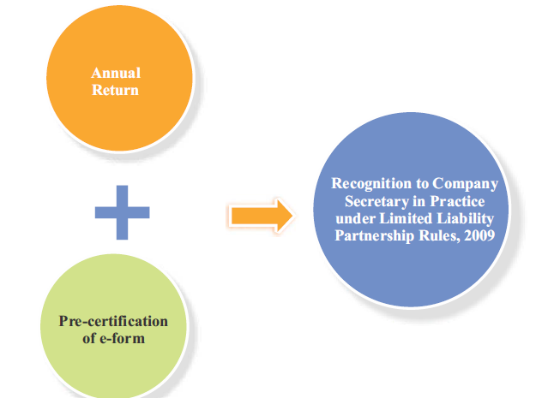

Slide 39
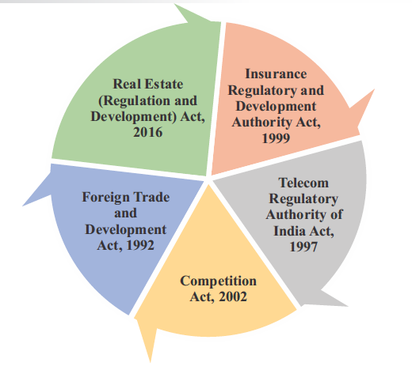

Slide 40
Conclusions
Looking at the historical background and the recognition given by various regulatory bodies in the last 3 decades, it heartening to celebrate the CS profession and expecting many more tangible recognitions to come from various stakeholders.
Time has come to respond to the expectations of trade & industry as well as government & various regulatory bodies by way of upgrading our skills and improving our delivery system.
Anyway, the word ‘governance’ is the hallmark of our professional and deeply recognized both in national and international fora.

Slide 41
Thank you &

