Slide 1



Impact of covid-19 on employment laws

Slide 2


Introduction
Covid-19 has attacked countries across the world and disabled the functioning of every sector. The impact is such that the recovery period cannot be anticipated conclusively at this stage.
The announcement of nation-wide lock down in India aimed at minimizing the spread of Covid-19. and thereafter issuing of chain of Government orders, advisories & schemes in an attempt to protect people.

Slide 3

Questions raised….
What are the legal obligations of employer to pay wages during a lockdown?
How to retain workforce during and after lockdown?
Are lay-offs the only answer?
Does the State have the right to intervene in the decision of the private employers?

Slide 4
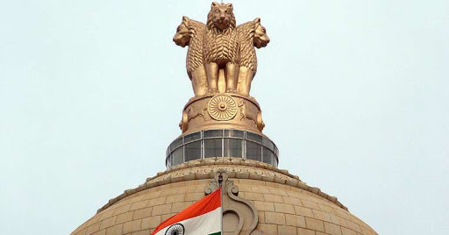
Orders by Central Government
Ministry of Labour and Employment advisory to all Public/ Private Establishments dated 20th March 2020 announced:
Not to terminate employees [particularly casual and contractual employees] or reduce their wages
If any worker takes leave, he should be deemed to be on duty and shall get full wages
If the workplace is made non-operational, the employees of such unit shall be deemed to be on duty

Slide 5
orders by
Central Government
Ministry of Home Affairs under the Disaster Management Act of 2005(DMA) order dated 29th March 2020,directed all employers to make payment of wages to workers on the due date without any deduction for the period of closure due to Covid-19 lockdown.
DMA has no provision to pass such order to govern employer and employee relationship during disaster.
Ministry of Home Affairs order dated 17th May 2020 said that all its earlier orders issued under DMA shall cease to have effect from 18th May 2020
Based on the order dated 18th May 2020, can Employer now deduct the salary or terminate the employees? [Case is pending before SC]

Slide 6

orders by state Government
Order dated 31st March 2020 of the Industries, Energy and Labour Department, Govt of Maharashtra issued under Disaster Management Act stating that all employees shall get complete salaries and allowances for the period of Covid-2019 lockdown
Similar orders were passed Delhi, Haryana and Gujarat Governments stating not to terminate employees or deduct their wages for the period of lockdown.

Slide 7

Legal tenability of the Steps
Government has not passed order under any Labour legislations [like shop Act, Factories Act, Payment of wages Act, Standing order Act or IDA] to avoid potential disputes- otherwise employers may have to comply with these laws and ensure payments thereunder like lay-off compensation, closure compensation, process for salary deduction etc.
Labour falls under concurrent list and both the government has power to enact legislations
DMA confers to power to issue guidelines or directors in response to any threatening disaster like Covid-19 to all people(including workmen)

Slide 8




Petitions in Supreme Court
Petitions have been filed to challenge the steps of the Government
Ludhiana Hand Tools Association v/s UOI – order directing payment to workers is challenged.
v/s UOI- both the order dated 20th March 2020 and 29th March 2020 are challenged.
Ficus Pax Private Limited v/s UOI – order directing payment to workers have been challenged. (Workers are not joining hoping that they will continue to get wages for the lockdown period. )

Slide 9
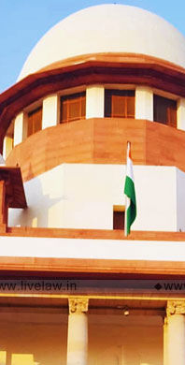

Grounds of Petitions in Supreme Court
Violation of fundamental and constitutional rights- Article 14 and 19(1)(g) and Article 300A –
Companies (specially MSME) can be forced into insolvency and loss of control business if they have to pay wages without any work on the part of employees – business has come down to 5%
There is no difference between workers who refutes to work and those who report- how to follow the principle of “equal pay for equal work”- WFH is not possible for all employees- Article 14
Directing companies to pay wages without reciprocal work on the part on employees is akin to taking away property of the company/employer – Article 300A
Payment of wages can be enforced only against consideration of performing work- unreasonable restrictions on the employer – Article 19(1)(g)

Slide 10
Grounds of Petitions in Supreme Court
MCA circular dated 10th April 2020–
As per the circular payment of salaries/ wages during the lockdown period is moral obligation.
Such payment of salaries does not qualify as CSR expenditure.
Limited powers under DMA–
Section 47 empowers the CG to constitute emergency fund for the purpose of mitigation of risk.
Even though CG can allocate the funds for the said purpose, it can not enforce financial obligations on private establishments

Slide 11
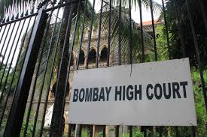
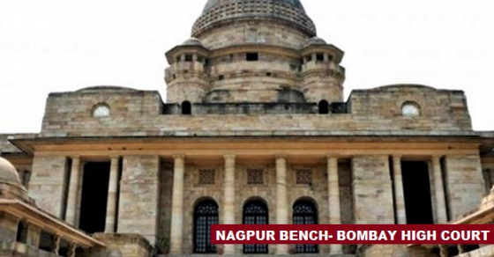
Decision
The Bombay HC in Align Components Private Limited v/s UOI – order dated 29th March 2020 was challenged – HC clarified that lockdown has partially lifted in few areas of Maharashtra and that the workers would be expected to report to duty and if they remain absent Management can deduct their wages as per Law.
The Nagpur bench of Bombay HC in C. H. Sharma v/s State of Maharashtra directed that State of Maharashtra to make arrangements for stay, food, shelter, sanitation, clothing and health care for the labourers including migrant labourers.

Slide 12

Actions by Employer
Lay-off – temporary suspension of employees- 45 days – cost cutting tool – COVID 19 has been declared as “natural calamity” by the Ministry of Finance on 19th February 2020 – Lay off are not applicable to managers/ supervisors
Retrenchment – termination of employees- downsizing- for any reason whatsoever- do not include natural calamity – employer have to pay compensation
Benching- occurs when employer unable to pay an employee – when skills are not matching with the available projects – remain on payroll without contributing to the output of the company
Furlough- mandatory suspension from work without pay - when employer does not have resource to pay –[ UK Government launch furlough wherein employers can furlough employees and claim 80% of their wages – cap is 2500 pound per week]
Invoking Force Majeure- rarely mentioned in the employment contract – depend on the offer or appointment letter

Slide 13

Actions by Employee
In National Alliance of Journalists v/s UOI- employers retrenchment, directions to go on leave without pay and salary cuts orders have been challenged – SC has given two weeks time to UOI to respond.
Air India employees have challenged employer’s order to deduct wages.
A petition has been filed against Steel Authority of India Limited and National Building Construction Corporation Limited for their orders directing employees to report to work

Slide 14
whether Wage payment is CSR?
Payment of salary/ wages in normal circumstances is a contractual and statutory obligation of the company.
Similarly, payment of salary/ wages to employees and workers even during the lockdown period is a moral obligation of the employers, as they have no alternative source of employment or livelihood during this period.
Thus, payment of salary/ wages to employees and workers during the lockdown period (including imposition of other social distancing requirements) shall not qualify as admissible CSR expenditure. [MCA General Circular No. 15 /2020 dt.10.04.2020]

Slide 15

Actions against Private Companies
WIPRO BOP Hinjewadi Pune has benched 300 of its employees on 23rd April 2020. Based on the complaint from National Information Technology Employees Senate(NITES), Pune Labour Commissioner office has issued show cause notice to WIPRO.
Pune Labour Commissioner office has also issued notice to Tech Mahindra Limited to cancel the order of pay cut and release the deducted salaries to employees.
Pune Labour Commissioner office has issued notice to Amdocs for firing 150 employees during lockdown

Slide 16
Impact of the notices issued
The notices issued by Labour authorities may be amenable to judicial scrutiny and are questionable .
In case of State of UP v/s Bridge Roof Company(India) Limited – 1996 –the court had discussed that matter of private contract cannot be agitated in writ petition.
Similar decisions was given in In Anupam Ghosh v/s UOI 1991.
All the orders are advisory in nature and they have made an appeal to pay salaries and not to sack employees during the period of lockdown.

Slide 17

Labour Welfare Measures
Ministry of Labour and Employment advised to use cess collected under the BOCW Act 1996 [ approx. Rs. 52,000 crs] for the construction's workers[approx. 3.5 workers are registered].
Officers of Ministry of Labour and Employment have donated 1 day’s salary to PM cares Fund.
Government has extended timelines/ due dates for PF, ESI, Annual return and contract labour license.
Under PMGKY, Govt. will pay both the shares of PF contribution for all employees whose gross wages are below Rs. 15,000/- [ condition of 90% ]

Slide 18
Labour Welfare Measures
Employee can withdraw 75% of their PF balance or 3 months salary, whichever is less from the EPFO account to improve his cash position .
PF authorities has granted relief to all commercial establishments and factories from levy of penal damages for delay in deposit of PF contributions or administrative charges during lockdown to prevent COVID-19.
EPF Department will not initiate any proceedings under section 14B of the EPF Act for such delay in payments due to economical and operational reasons on the part of Employer.
ESI has declared COVID-19 as sickness and employees those are at home can claim sickness benefits from EISC.

Slide 19

Exemptions from Labour Laws
Government of Uttar Pradesh has exempted all factories and commercial establishments from all labour laws provisions for a period of 3 years. [ No such ordinance in Maharashtra] .
Government of Maharashtra has give exemption from the provisions of the Factories Act like weekly hours, weekly off, daily hours and spread over.
Factories in Maharashtra are permitted to work in two shifts of 12 hours each subject of payment of overtime.
No workmen should be allowed to work beyond 12 hours.
The spread over should not be more than 13 hours.
The weekly hours should not exceed 60.
The overtime hours should not exceed 115 in a quarter.
Precautions in relation to social distancing to be followed.
[ No such changes in the provision of Shop Act 2017].

Slide 20

New proposals

Slide 22

Policy decisions
68% companies has started process of termination of employees – worker - IDA and manager – offer letter
73% companies has resorted to pay cuts.
57% companies has commence the process of Lay-off.
32% companies has decided not to terminate employees.
70 companies adopted WFH.
Domestic workers need wages or work.- resistance from families

Slide 23

Action plan to combat covid-19
Establishments have deferred their promotion and increment cycles. They will relook statutory bonus and performance bonus.
Establishments have extended health insurance plans to their employees.
Establishments have changed their leave plans like unpaid leave, furlough etc
Establishment have increased notice period to retain and replace manpower.
Establishments will design plan of compensation and benefits based on the turnover before and after lockdown.

Slide 24
Action plan to combat covid-19
Establishments will cut down the cost on crèche facility, transport, subsidized food, trips, and transfer these benefits to employees in other form.
Establishments will re-design their compensation structure to adapt to the changing scenario. Redefining existing flexible allowance and relevant employee expenses.
IT/ ITES establishments will ask their employees to work as per WFH policy till further notice [TCS – for next two years]

Slide 25

Responsibilities
Employer
Providing a safe work place and appropriate resources for working from home (“WFH”);
Reimbursing the employees for the expenses incurred while working from home including internet access.
Promoting video conferencing for meetings over face-to-face meetings;
Providing information, instructions, trainings and supervision regarding safety and health to employees.
Employee
To cooperate with their employer and follow instructions,
To protect themselves and others from harm during the course of their work as well as the official equipment like laptop, data security etc.
To report any injury arising from work activity to their employer immediately.
To contribute actively to the output of the employer

Slide 26
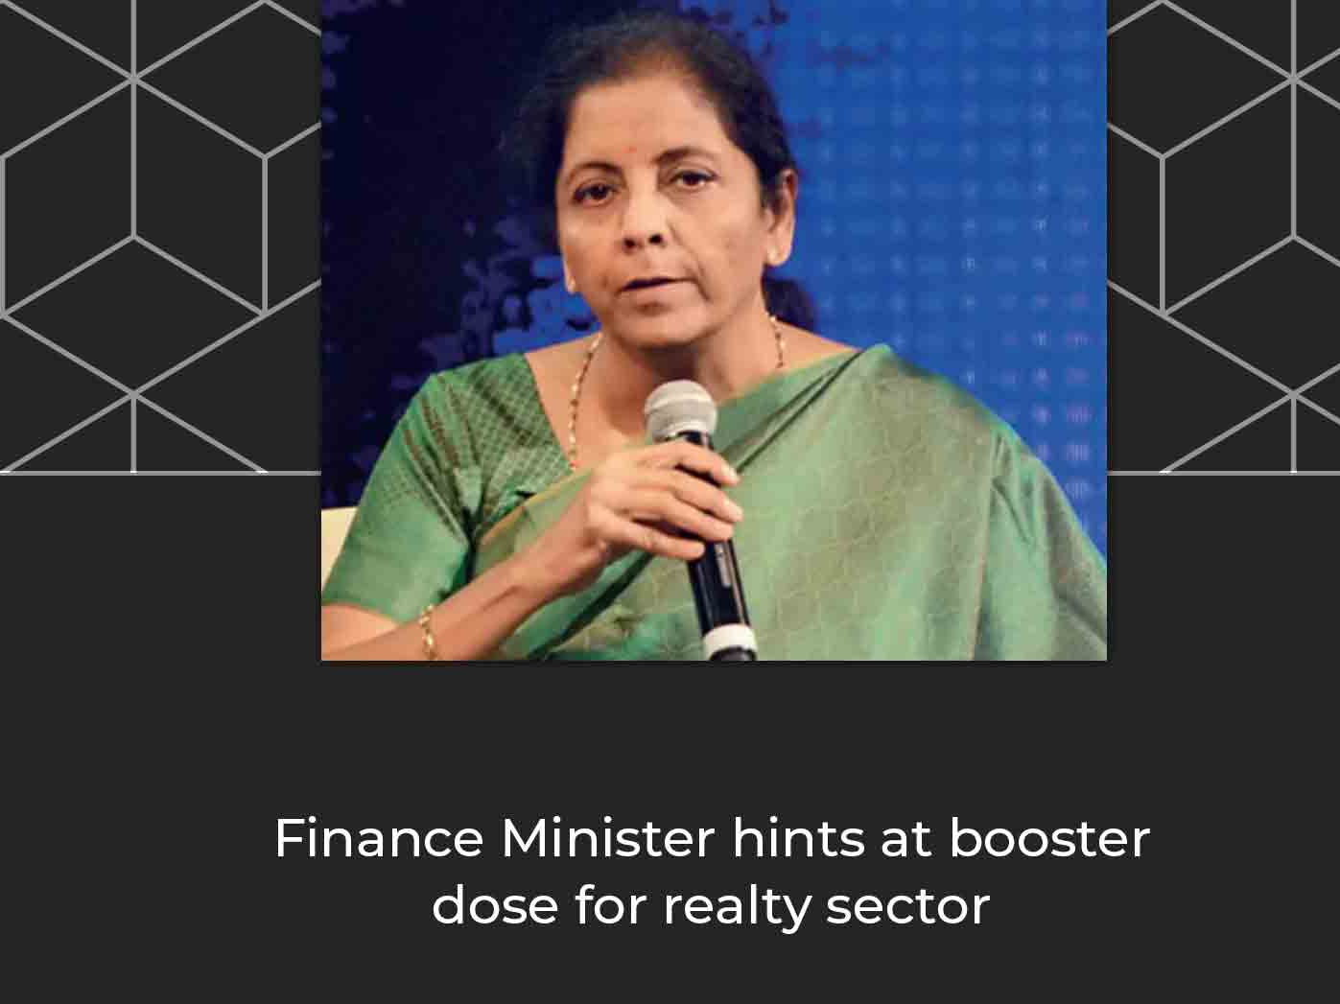

Announcement by Finance Minister
Summary of Announcements regarding Labour Laws by the Honorable Finance Minister under Atmanirbhar Bharat Scheme.

Slide 27

KEY HIGHLIGHTS
Reduction of contribution rate to 10% from exiting 12% (both shares) for next three months – May, June and July 2020 – with 3 options
Extension of PMGKY Scheme by further three months i.e. June, July, August- 2020 – condition of 90% of employees – not acceptable to the Industry
Reduced Rate Not Applicable to CPSE and State PSUs

Slide 28

KEY HIGHLIGHTS
ESI will be applicable to all establishments engaging 10 or more employees – with or without manufacturing activities
ESI will be compulsory for units engaged in hazardous process even with less than 10 employees
Voluntary Coverage for establishments with less than 10 employees.
ESI will be made applicable across all districts.

Slide 29
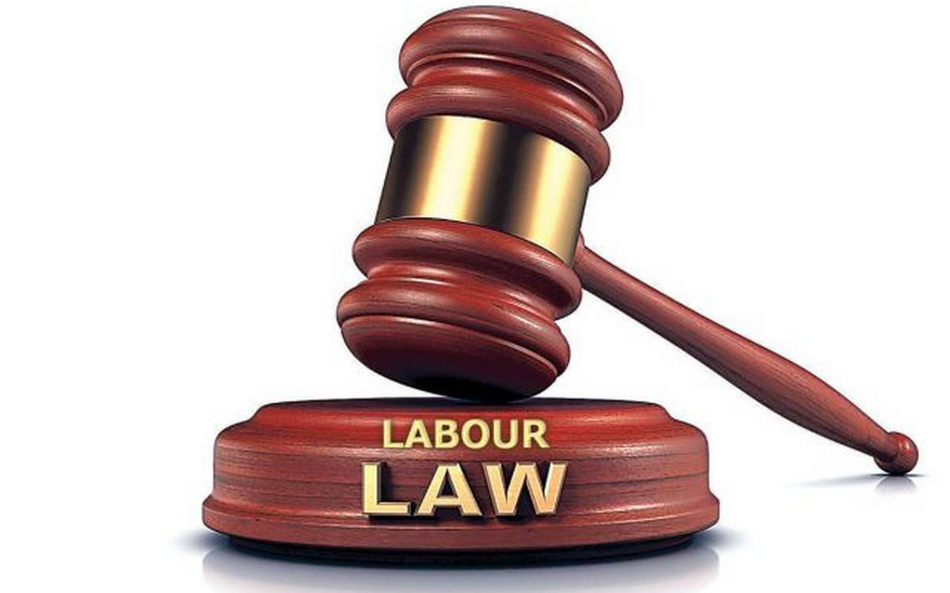
KEY HIGHLIGHTS
There will be concept of National Floor Wage to address the problem of disparity in minimum wages across different states and sectors.
Mandatory issue of Appointment Letter – Govt. will provide format
The Gratuity Entitlements to employees hired under Fixed Term Employment – one year as against 5 years – contributory like Pf – will be a part of CTC
Reskilling of Retrenched workers.
Bringing Inter State Migrant Workers under an organized sector.
Mandatory Annual Health Check for all employees
Portability of welfare benefits for migrant workers.
The government intends to subsume 44 labour laws into four Labour Codes to simplify the compliance ecosystem.

Slide 30

AWAITING CLARITY…
What is the effective of these announcements? – Not clear
Whether Labour authorities will conduct scrutiny of those companies who has taken benefits of the scheme like PMGKY etc.? – PF Dept. seek information from all employers.
What are the exemption from Labour law provisions after lifting of the lockdown?
Whether Government will extend loans to the employees of private employer?

Slide 31

Government shall give exemptions from all labour laws provisions for specific period.
Government shall balance interest of employer and employee
Employer to comply with the new labour codes and change the polices as per changes in the new labour codes.
Employee to extend cooperation to the Employer and contribute actively to achieve the turnover

Slide 32

Happy to take your
Questions

Slide 33

CS SANDEEP M. NAGARKAR

