Slide 1



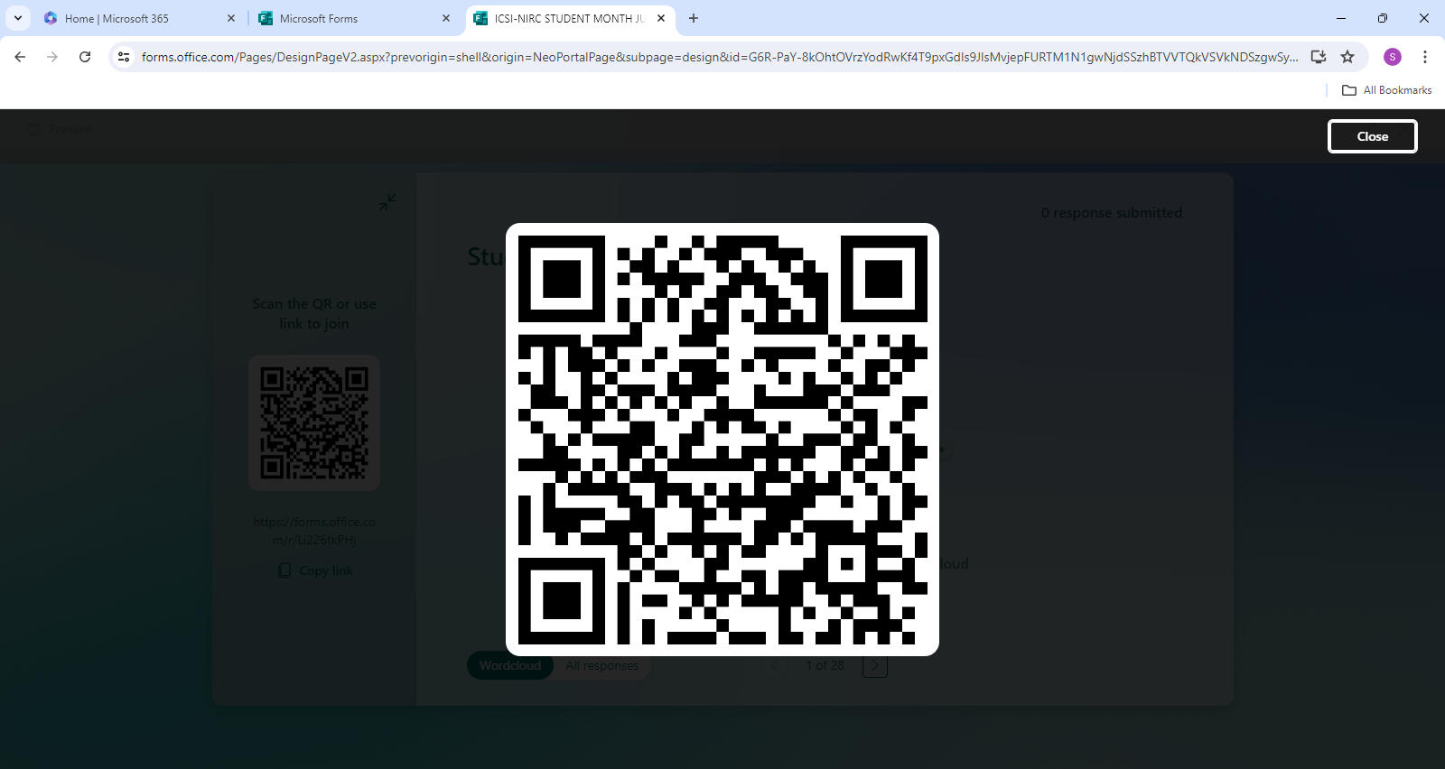
ICSI-NIRC Cordially Invites Students to Participate in Student Month Activities
Session on Topics:
Soft skills: Communication
10th July, 2024 (Wednesday)
11:00 AM to 1:00 PM
Venue: ICSI-NIRC Building, Plot No.4, Prasad Nagar, Institutional Area, New Delhi 110005
Registration QR code:
Registration Link:
https://tinyurl.com/student-month2024
For more information mail at niro@icsi.edu or Contact : 011-49343006-07 (10 AM to 5 PM)
Or Visit: https://www.icsi.edu/niro/home/
With Warm Regards
CS Jatin Singal
Chairman
CS Himanshu Harbola
Secretary

