Slide 1
Name: - Sanchita Kumari
Registration number: - 140576848/11/2018
Stage:- Executive (New)
Jamshedpur Chapter

Slide 2
Challenges faced by the company secretaries during corona virus and lockdown period

Slide 3
What Really is COVID-19 ??
Coronavirus disease (COVID-19) is an infectious disease caused by a newly discovered coronavirus. The COVID-19 virus spreads primarily through droplets of saliva or discharge from the nose when an infected person coughs or sneezes, so it’s important that you also practice respiratory etiquette

Slide 4
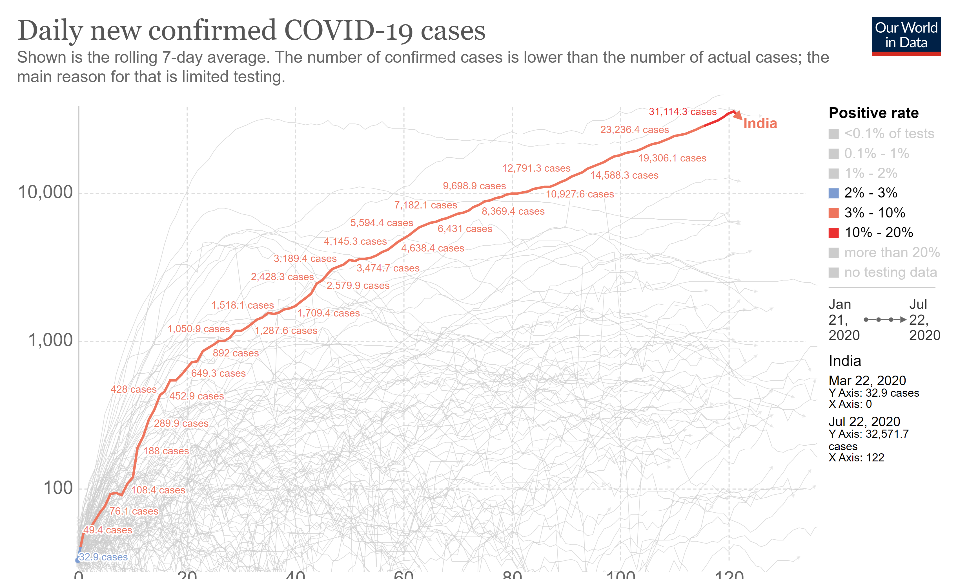
The Rise of COVID-19 in INDIA
Around 30K+ cases are being reported every day now.
The Death rate is low but the fact that the cases are increasing may increase the death rate in the coming future.
According to reports, India is doing 180 tests per day per million

Slide 5
Effect on Job due to the pandemic
Which sectors would face the highest job losses?
Aviation
Automobile
Travel and tourism
Food
Entertainment
Manufacturing
Which sectors would do good despite the Covid-19 crisis?
Healthcare
Pharmaceuticals
e-commerce
IT services
Essential retail

Slide 6
Why India is losing Job??
The biggest reason is that the whole country is under a lockdown phase and every type of business or service was put on a hold.
From a large business capital to a small size service farm, everyone was facing crises in raising money and to pay the employee their salaries, In order to compensate the loss, the firms started to lay off their employees.
The major sector who loosed their livelihood was all the MSME people who started their business as seeing a job opportunity and faced a fall due to the pandemic.
The Sensex on 12th Feb before the Covid-19 crisis entered India was around 41000 and in a spam of 1 month it came down to 25000 which shows how badly the industries were affected.

Slide 7
What are the problems Company Secretaries are Facing??
As a teacher in CS Field:-
Due to the pandemic many of the institue and coaching classes are closed, many of the faculty is still trying to complete their left-over portion on time so that the student can prepare for the exams.
Earlier where everything was on an offline basis and in the current scenario things are shifting toward digital platform, it is hard for everyone to shift to a new way of teaching and learning, teachers are facing problem to conduct the classes online due to lack of resources and new change in pattern, similarly student are also facing many issues in adopting the new way of teaching.

Slide 8
Working People in Private Sector
People who are working as professionals are facing a lot of issue in this crises:-
The lack of transport facilites from one place to another will affect the job
As money is not circulating in the market and every other companies is been shut down or working at half of their capacity it is hard to pay salaries to employee so lot of them are losing jobs.
As everything is shifting to an online infrastructure a smaller number of people are needed to do a job rather than a big crowd and thereby reducing the employee force.
As in private sector each company has one or two company secretary, so the number is being reduced.
Working People in Public Sector
As government industries there is a smaller number of job losses but the employment scale for new job has been towards a low level in these situations.
Many of them who just completed the course are waiting to just get placed in some companies, but they are put on hold because of the current pandemic.
As government is not getting enough funds from the various taxes, they are not able to generate proper employment in the covid situation.

Slide 9
Industries Which are worst Affected

Slide 10
Hindustan Petroleum Corporation
It is a government sector organization which was the best in its business.
Due to the covid-19 pandemic all the subsidiary of it where shut down there was a great loss as in the month of march to april the company shares started to fall.
As no money was circulated no jobs were created and no employment was generated.

Slide 11
Indian Tourism Development Corporation
Almost 10% of India's GDP is contributed by the Tourism Sector.
Due to the complete lockdown many of the companiess have totally shut their business either it is a big firm or a MSME.
People across the nation have sacrificed their job due to the sudden crises.

Slide 12
Interglobe Aviation
One of the major player in the Aviation sector of India.
Indigo compramises around 60% of the indian aviation sector economy.
Lost huge amount of money as airlines are oprated on a low profit margin.

Slide 13
Industries which saw a great rise to their capital

Slide 14
HDFC Life Insurance
One of the biggest insurance company in India.
As People are getting aware of the current situation more and more people are taking life insurance to save their lives from upcoming situation.
Due to the sudden spike in this sector people are getting jobs as a greater number of people are required to fulfill the requirement.

Slide 15
Cipla
One of the largest sector in Health Care.
Leading manufacture of medicine in India.
As the Covid-19 has increase the need of medicine the Pharma sector is showing a growth of lifetime.

Slide 16
So why this company data is Important??
As you can see given above is the data of the few top companies in their own sector, because of the crises everything is gone hap-hazard no one was prepared for such a worse condition. Companies performing well had taken an exponential decrease which can be seen on the stock market chart. A loss in a company will affect all its employee whether it is the CEO of the company or the clerk, so many CS graduate had loss their job or can't complete their articleship in these times, and in these tough times no body is offering and job as it is not possible to hire fresh talents.
But there Is always two side of a coin which is the same in case of this pandemic where sectors like aviation, bank, private are hit hard there are some like health, Insurance,E-commerce sector which have seen boom into their cpital. More and more work is done due to the need of sudden equipments and medicine and every company is trying their luck to take this oppurtunity.For eg:- Only few N 95 mask were made in India but now more than 2Lkhs of mask are being manufactured every day. As government has made new advancement to MSME sector and the growth of startups new and major job oppurtunity has been created for the CS graduate, which can be seen like an icing on the cake in this tough times.

Slide 17
Opportunity in this Pandemic
As we know everything is getting transferred from an offline mode to an online mode, government is making more efforts in digtalizing things rather than manual work. For eg:- MCQ website are coming to take all the exams which takes place in an academic calendar, Board meeting are now shifting to online pattern through digital platform, all the quaterly compliance of stock market and the reports are send digitally to the government. So how to do all these things how to tackle all the problem which will be faced during this turnover is maintained and governed by a CS only. A CS graduate can apply all the laws from the company and can tell the board of directors.
Government has launched many scheme regarding the MSME sector and startup company and all these things need a consultancy service which can only be done by a CS because a CS graduate only knows which law is applicable to whom and how to in coporate the changes.
In future a CS can help in ease of doing business as all the advice is given by CS person.
CS will also play a major role in IBC, company fresh start scheme in 2020.
Use the crisis as an opportunity and catalyst for change, but don't push it too far.

Slide 18
Seeds of faith are always within us, sometimes it takes a crisis to nourish and encourage their growth
- Susan L. Taylor
Thank You

